Slide 1
E-Commerce Sales Analysis and Dashboard
Analysing Sales Data Across Various Product Categories and Regions
25th July 2024
by
Golden Osabuohien

Slide 2
Introduction
Objective: To analyse the sales and profitability of different product categories and regions.
Goal: To provide insights for strategic decision-making and enhance overall business performance.
Description: The dataset contains sales data for different product categories, including order details, shipment information, sales amount, quantity, discount, profit, shipping cost, and customer details.
- Key Features: Order ID, Order Date, Ship Date, Product Category, Sales, Quantity, Discount, Profit, Shipping Cost, Customer Details, Region, and Months.

Slide 3
Data Formatting, Preparation and Analysis
-Data Formatting
Highlighted duplicate records.
Used icon sets to indicate data changes.
Formatted dates to dd-mmm-yy format.
Created a table of Sales & Profit month-wise.
Calculated average profit and sales for each product category, region-wise.
- Identified top 3 highest performing products and bottom 3 lowest performing products.

Slide 4
Summarised Insights
Monthly Trends:
- Fluctuations: Both profit and sales fluctuate across months.
- January Peak: Highest profit ($313,566.34) and sales ($675,313).
- June and February Low: Lowest profit in June ($302,231.92) and lowest sales in February ($610,240).
Comparison Between Profit and Sales:
- Consistent Sales: Sales values are relatively stable, ranging from $610,240 to $693,073.
- Variable Profit: Profit shows significant variation, indicating influences beyond sales volume, like cost management or seasonal discounts.
Quarterly Analysis:
- Q1 (Jan-Mar): Strong performance in profit and sales.
- Q2 (Apr-Jun): Dip in profit despite stable sales.
- Q3 (Jul-Sep): Recovery in profit with stable sales.
- (Oct-Dec): Strong profit and sales, especially in December.
Month-wise Sales & Profit Analysis
.

Slide 5
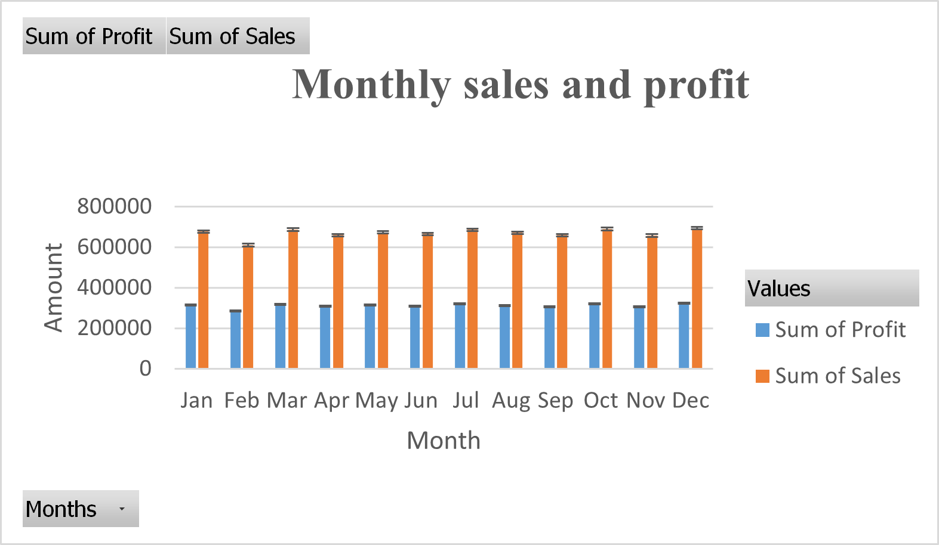
Annual Performance:
- Total Profit: $3,729,902.95
- Total Sales: $8,023,381
- Profit Margin: Approximately 46.5%.
Potential Factors for Analysis:
- June Profit Dip: Investigate reasons for the drop in profit.
- High January & December: Explore strategies for high profitability and sales.
Cost Structure: Examine cost management and operational efficiency to understand monthly profit variations.

Slide 6
AVERAGE PROFIT FOR PRODUCT CATEGORY, REGION-WISE.
- Average profits for Auto & Accessories, Electronics, Fashion, and Home & Furniture are shown.
- Regions: Profits are displayed in different colours for multiple regions.
Product Category Insights:
- Auto & Accessories: Consistent regional profits, averaging 60-70 units.
- Electronics: Similar consistency as Auto & Accessories, with profits between 55-70 units.
- Fashion: The highest average profits range from 70-80 units, making it the most profitable category.
- Home & Furniture: Lower average profits (40-65 units) with more regional variation.
Regional Insights:
- Africa & Canada: Stable profits across all categories.
- Caribbean: Higher profit variability, especially in Fashion and Home & Furniture.
- Central & Central Asia: Consistent profits across categories, with Fashion being the most profitable.
- Other Regions (East, EMEA, North, North Asia, Oceania, South): Similar trends with slight variations. Fashion is consistently profitable, while Home & Furniture shows more variability.

Slide 7
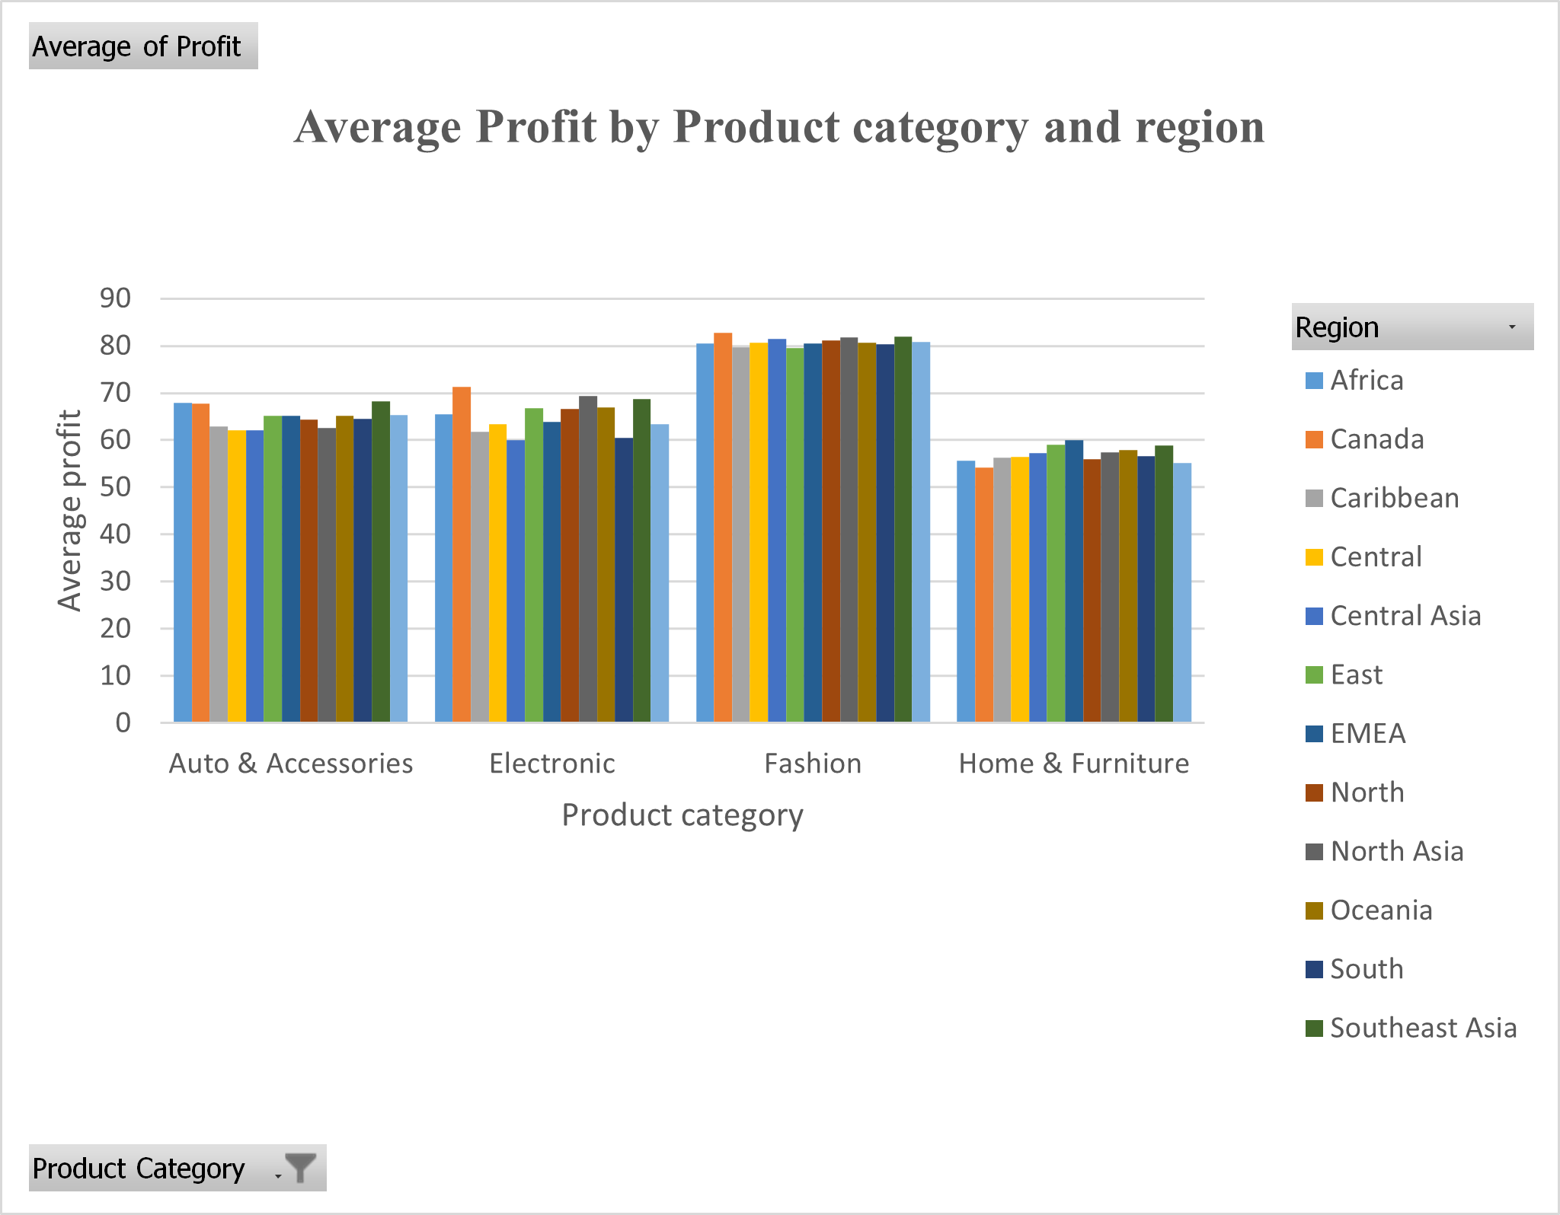
Key Observations:
- Fashion: Most profitable category across all regions.
- Home & Furniture: Most profit variation indicates different market dynamics or costs.
- Auto & Accessories and Electronics: Consistent profits suggest stable market conditions or effective pricing strategies.
Potential Areas for Further Analysis:
- Fashion: Investigate factors contributing to high profitability.
- Home & Furniture: Explore reasons behind profit variability across regions.
Auto & Accessories and Electronics: Analyse cost structures and market conditions to maintain or improve profitability.

Slide 8
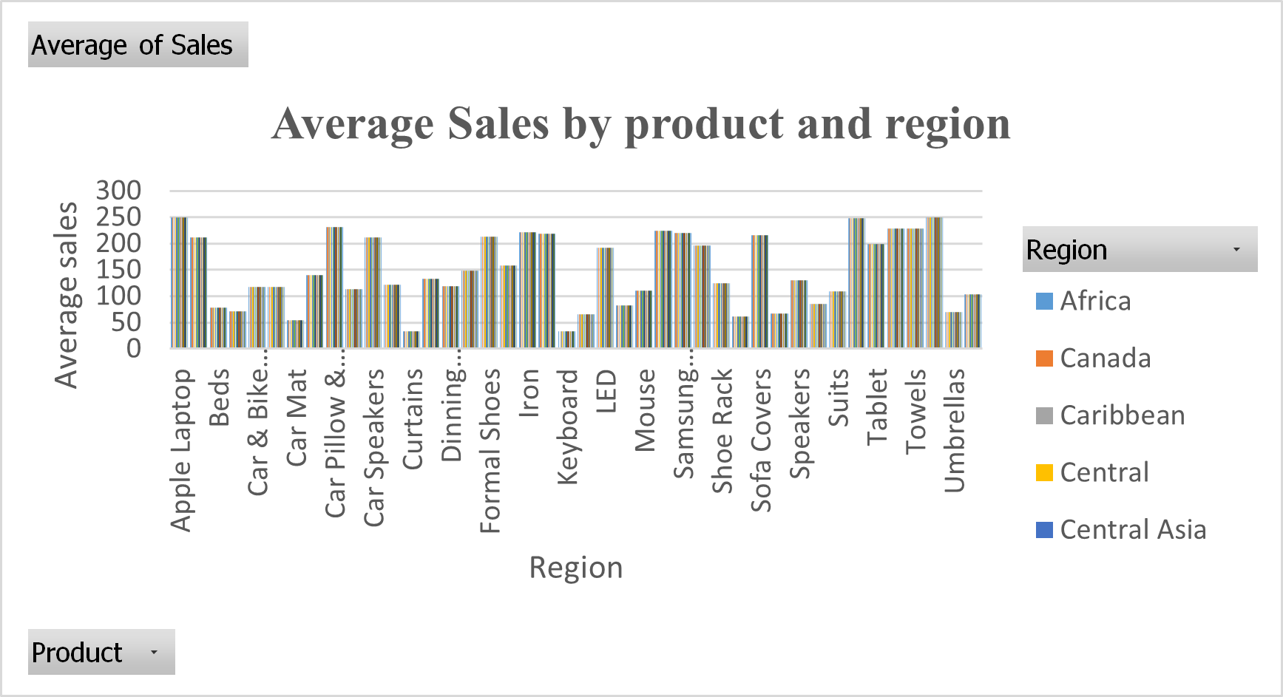
Summarised Insights: Average sales of a product, region-wise
Overall Trends:
The chart shows average product sales across multiple regions, with different colored bars representing each region.
Regional Insights:
- Africa: Moderate sales for most products with a few high-performing items.
- Canada: Higher sales for a few products, particularly Apple Laptops and Samsung Mobiles.
- Caribbean: Moderate to high sales for diverse products, with peaks in specific items.
Central, Central Asia, East, EMEA, North, North Asia, Oceania, South: Consistent sales patterns with occasional peaks, indicating stable markets with certain high-demand products.

Slide 9
Key Observations:
- Electronics: There are high average sales for Apple Laptops and Samsung Mobiles in several regions, indicating strong demand.
- Home Products: Sales for items like Beds, Curtains, Dining Tables, and Towels have remained stable across regions, suggesting broad market appeal.
- Fashion and Accessories: Varied sales for products like Formal Shoes, Suits, and Umbrellas, indicating regional preferences.
Potential Areas for Further Analysis:
- High Sales Factors: Identify factors driving high sales of specific products in certain regions.
- Market Conditions and Promotions: Investigate market conditions and promotional strategies influencing sales patterns.
- Enhancing Sales: Explore opportunities to enhance sales in regions with lower performance for high-potential products.

Slide 10
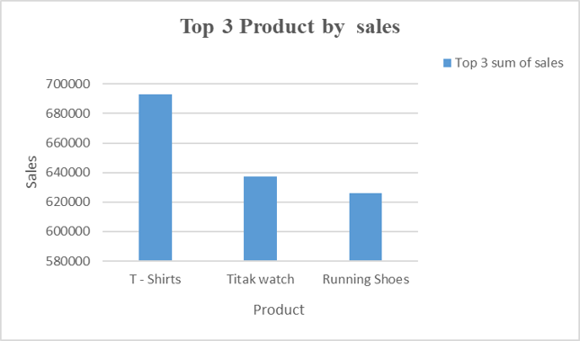
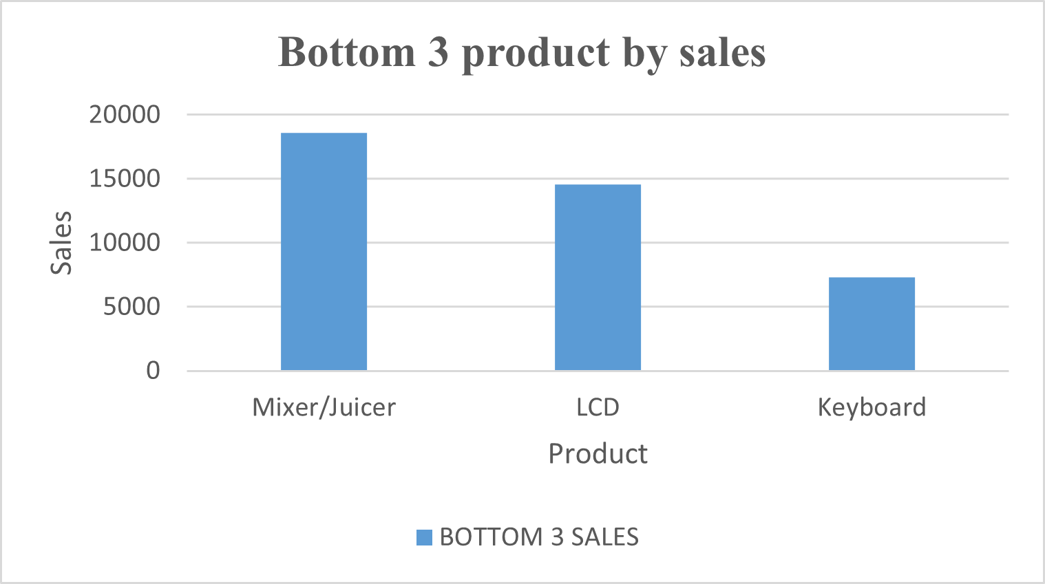
Summarised Insights: Top and Bottom 3 products
Key Observations:
- High Demand Products: T-shirts, TikWatch, and Running Shoes are high-demand products, suggesting successful marketing strategies or high consumer interest.
Low-Demand Products: Mixer/Juicer, LCD, and Keyboard sales are significantly lower, indicating potential areas for improvement in marketing, pricing, or product features.

Slide 11
Potential Strategies:
- Boosting Low Sales Products:
- Conduct market research to understand the reasons behind low sales.
- Enhance product features, adjust prices, and improve marketing efforts to boost sales.
- Leveraging High Sales Products:
- Capitalize on the success of T-shirts, TikWatch, and Running Shoes by expanding the product line.
- Increase marketing efforts and offer bundled deals to increase sales further.
Further Analysis:
- High Sales Factors: Examine factors contributing to the high sales of top-performing products.
- Customer Feedback: Investigate customer feedback and market trends for low-performing products.
- Regional Performance: Analyse the regional performance of these products to identify specific markets where improvements or additional efforts are needed.

Slide 12
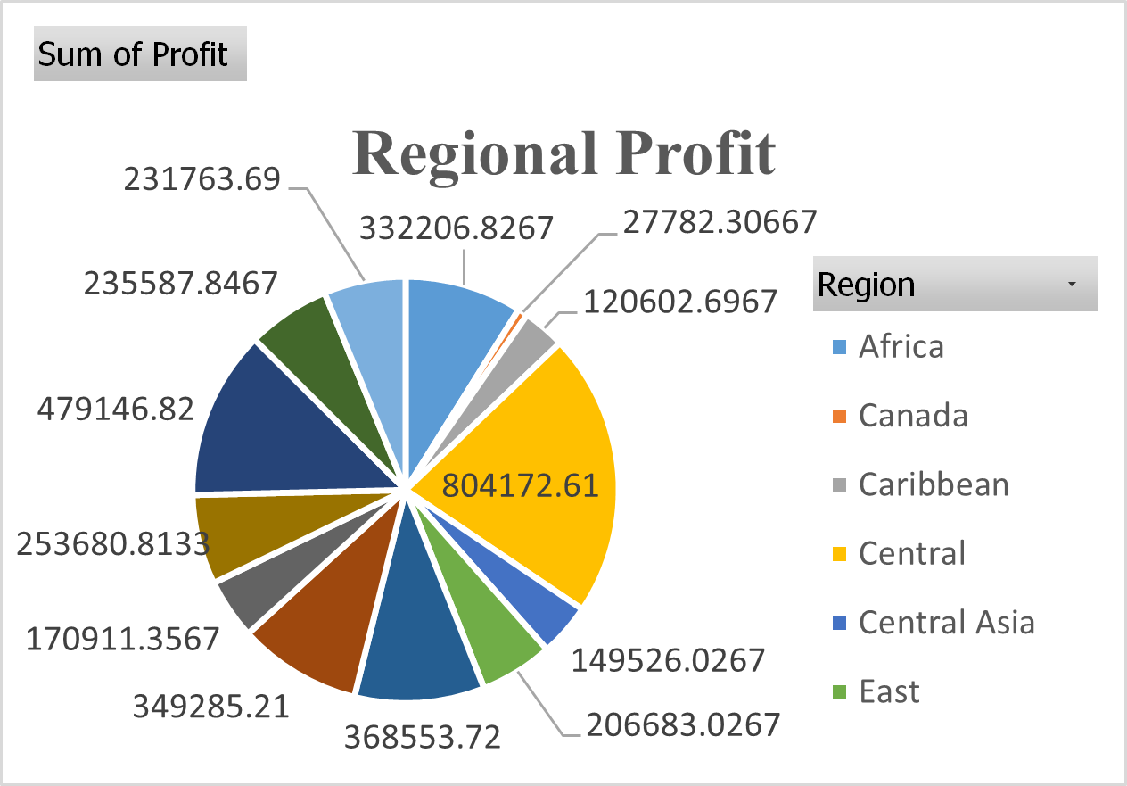
Regional Profit Insights
Regional Distribution:
Key Observations:
- Central Region: Significant profit centre; analyse strategies driving success.
- Less Profitable Regions: Require targeted strategies such as market research, tailored marketing campaigns, and pricing strategies.

Slide 13
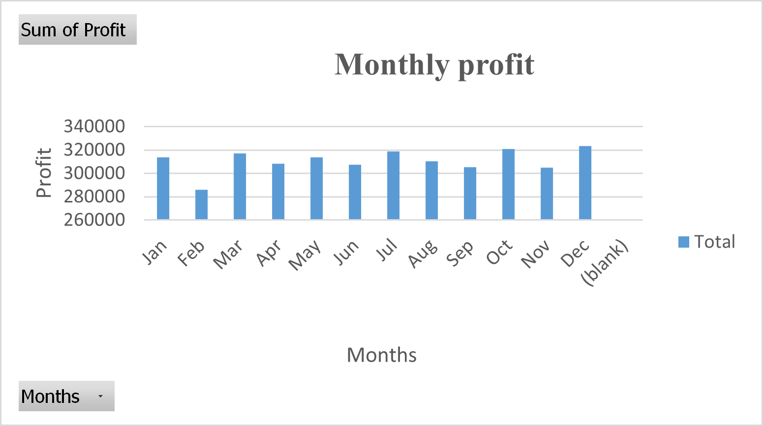
Monthly Profit Insights
Monthly Trends:
- Higher Profit: January ($313,566.35) and December ($323,401.92), possibly influenced by post-holiday and year-end sales.
- Lowest Profit: June ($302,231.92), potentially due to seasonality or other factors.
Stability and Fluctuations:
- Profits remain relatively stable throughout the year, with minor fluctuations.
- Mid-year months (May to September) maintain a steady profit range around $307,000 to $310,000.
Key Observations:
- High-Profit Months: Examine successful tactics in January and December for application in other periods.
- Low-Profit Months: Review operational strategies, promotional activities, and market conditions to identify improvement opportunities.

Slide 14
Conclusion Statement
From a data analyst perspective, the comprehensive analysis of the e-commerce sales data reveals critical insights into regional and monthly profit trends. The Central region emerges as the most significant profit centre, suggesting effective strategies that could be replicated in lower-performing regions such as Central Asia, South and Africa. Monthly analysis highlights January and December as peak profit periods, driven by strategic post-holiday and year-end sales tactics. Conversely, June’s profit dip calls for a review of operational and promotional strategies to mitigate mid-year performance issues. By leveraging the successful strategies identified and addressing the areas needing improvement, the organisation can optimise its sales performance and enhance overall profitability.

